Slide 1
PARICHAYA
AN IDENTITY STORAGE AND SHARING APP
AARYAN SHARMA (LEC075BCT008)
ASIM NEPAL (LEC075BCT003)
NISCHAL SHAKYA (LEC075BCT010)
KUSHAL KOIRALA (LEC075BCT020)
Department of Computer Engineering
Lalitpur Engineering College
24 February, 2022

Slide 2
INTRODUCTION
WHAT IS PARICHAYA?
WHY USE OUR APP AMONG OTHERS?

Slide 3
INTRODUCTION
Helps to store personal and sensitive information
Offline viewing of app
Helps to share the selective information to the person who are in need of our information
User is in control of their own information

Slide 4
OBJECTIVES
To provide a user friendly platform to store personal documents and credentials, which can be shared easily, for convenience and security purposes.

Slide 5
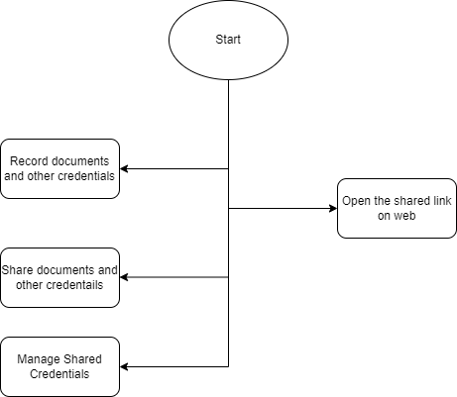
SYSTEM OVERVIEW
Fig 1: System Block Diagram

Slide 6
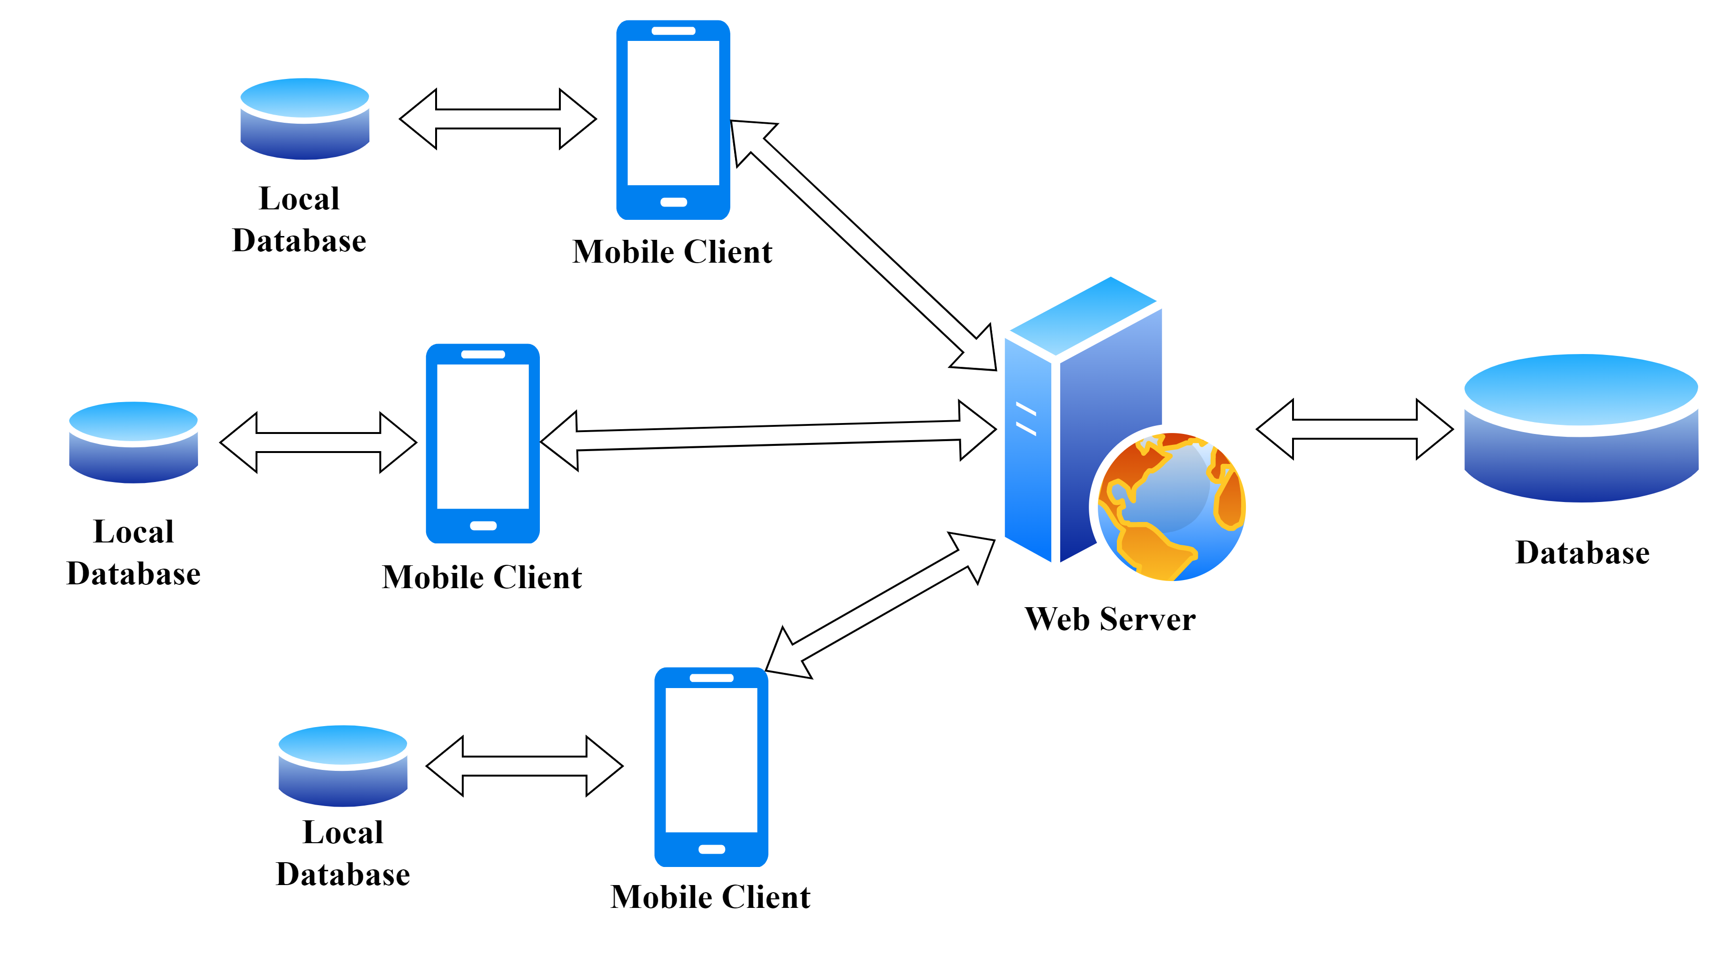
WORKING PRINCIPLE
Fig 2: Client Server Architecture

Slide 7

DATA FLOW DIAGRAM
Fig 3: Level 0 DFD

Slide 8
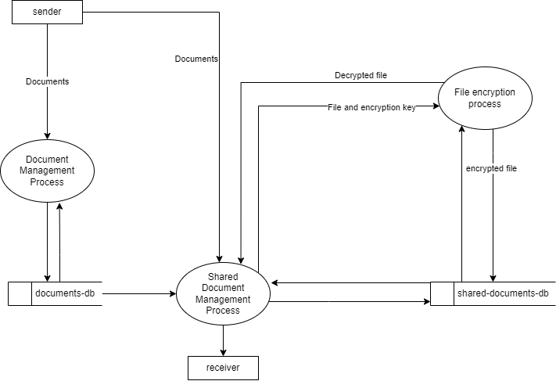
DATA FLOW DIAGRAM
Fig 4: Level 1 DFD

Slide 9
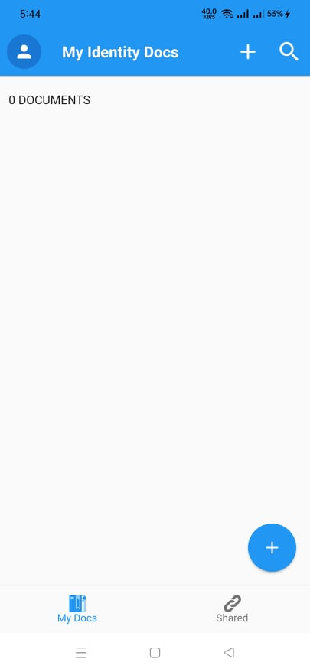
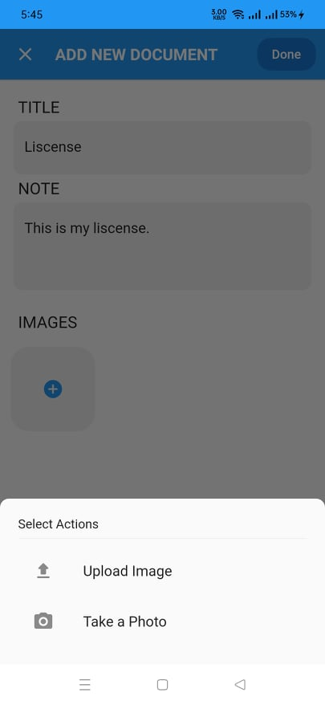
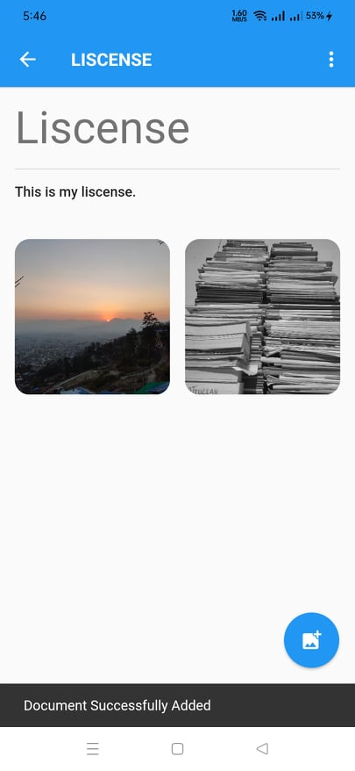
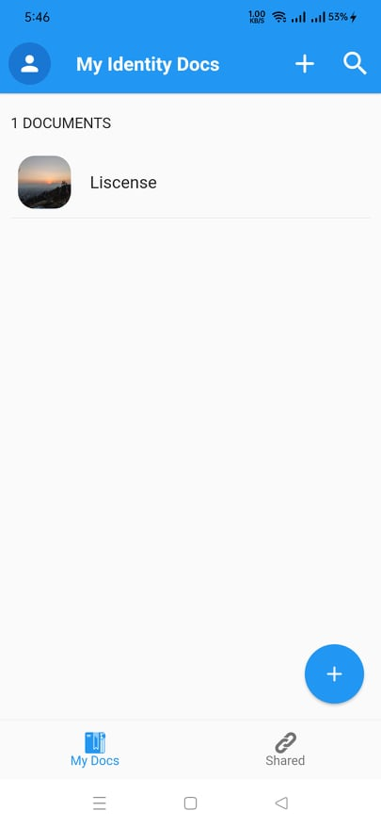
WORK ACCOMPLISHED
Adding Document

Slide 10
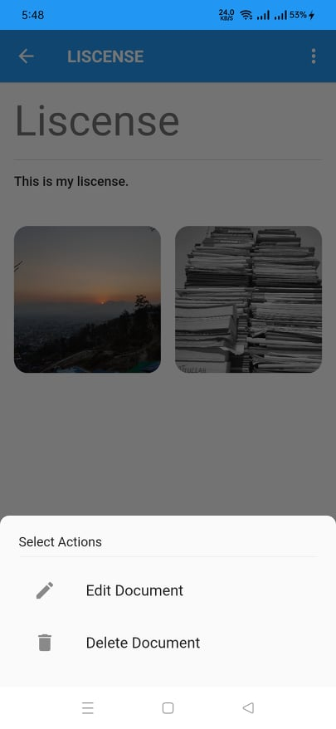
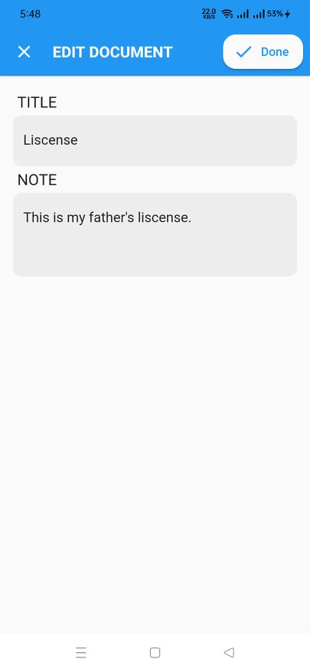

WORK ACCOMPLISHED
Editing Document

Slide 11
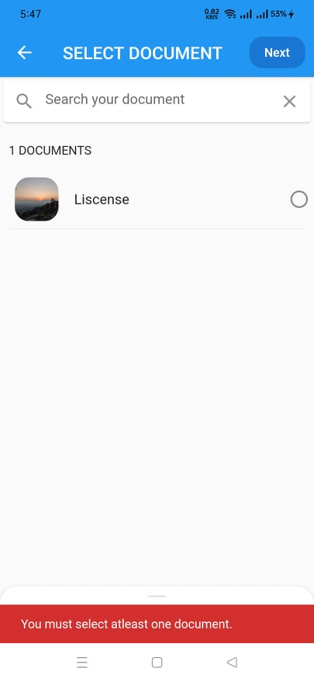
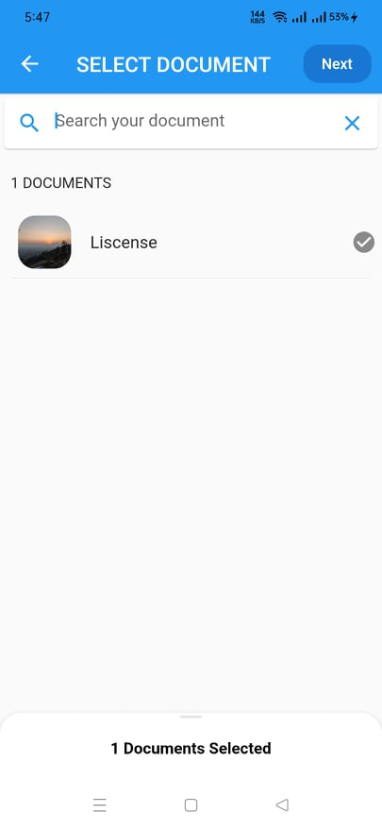
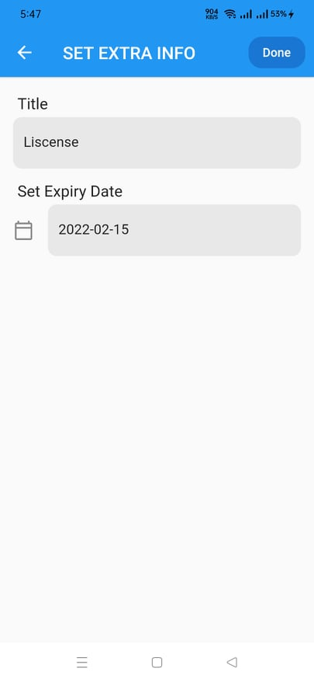
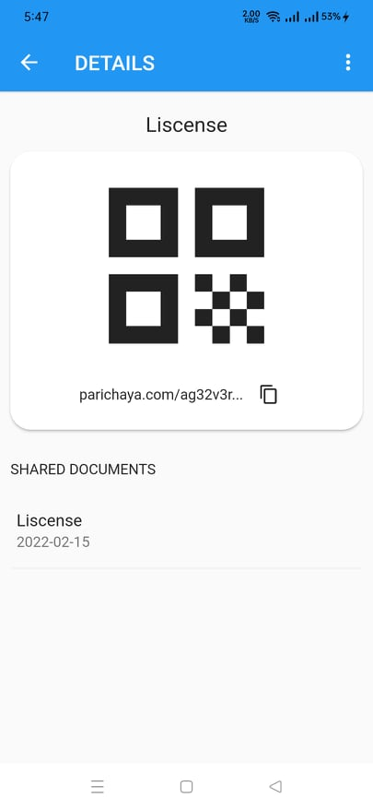
WORK ACCOMPLISHED
Sharing Document

Slide 12
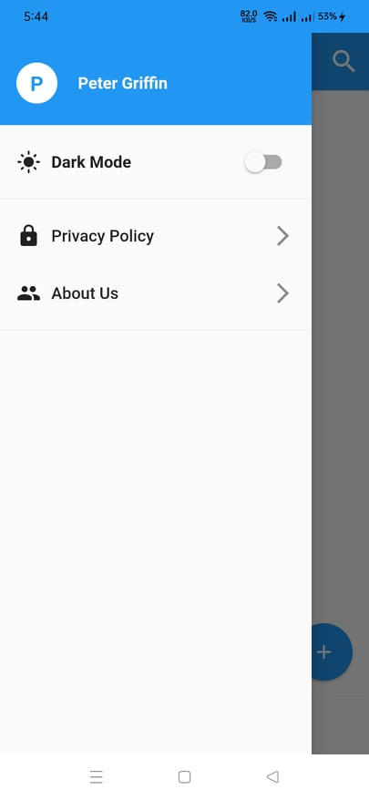
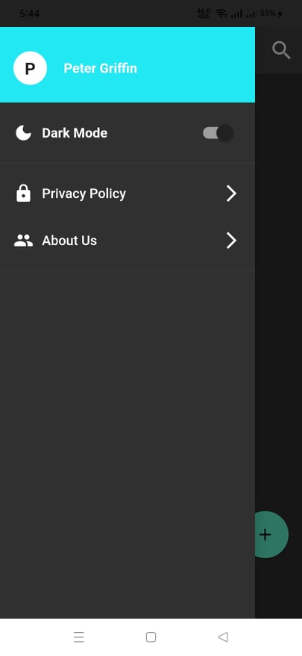
WORK ACCOMPLISHED
Dark Mode✨
Light Mode
Dark Mode

Slide 13
REMAINING TASKS
Add Document Scanner
Customize fonts and theme
Implement Image skeleton loader
Create web-app to view shared link
Add logo to app
Create APK build

Slide 14
PROGRESSION TIMELINE
55 DAYS
55 DAYS
13 DAYS
47 DAYS
Fig 6: Gantt Chart

Slide 15

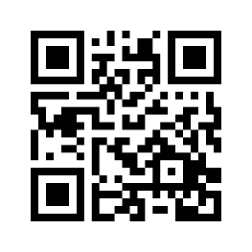
PARICHAYA
Soon
Available on App Store
THANK YOU!!!

